Slide 1
Probability Distribution

Slide 2
By examining the chest X ray, the probability that TB is detected when a person is actually suffering is 0.99. The probability of an healthy person diagnosed to have TB is 0.001. In a certain city, 1 in 1000 people suffers from TB. A person is selected at random and is diagnosed to have TB. What is the probability that he actually has TB?
TB detected
0.99
P(A person is selected at random and is diagnosed to have TB)=
(1/1000)*0.99+(999/1000)*0.001
P(actually has TB)=
P(Suffering and TB detected)/P(A person is selected at random and is diagnosed to have TB)
0.99*(1/1000)
((1/1000)*0.99+(999/1000)*0.001)
1/1000
Suffering
TB not detected
0.01
TB detected
0.001
Not Suffering
999/1000
TB not detected
0.999

Slide 3
Suppose that 6% of the people with blood group O are left handed and 10% of those with other blood groups are left handed 30% of the people have blood group O. If a left handed person is selected at random, what is the probability that he/she will have blood group O?
Left handed
0.06
P(A person is selected at random and is left handed have blood group O)=
0.3*0.06 / (0.3*0.06+0.7*0.10)
0.3
O Blood Group
Right handed
0.94
Not O Blood Group
Left handed
0.10
0.7
Right handed
0.9

Slide 4
Event Types
Independent (each event is not affected by other events),
Dependent (also called "Conditional", where an event is affected by other events)
Mutually Exclusive (events can't happen at the same time)
Equally Likely: probability is equal

Slide 5
Random Variables

Slide 6
Random Variables
Something is random when it varies by chance
a numerical characteristic that takes on different values due to chance
Example: Rolling a die there are six equally possible outcomes, the observed outcome on any one roll is random.

Slide 7
Types
A discrete random variable has a countable set of distinct possible values.
Number of classes missed last week (possible outcomes are 0, 1, 2, 3, ..., up to the maximum number of classes)
A continuous random variable is such that any value (to any number of decimal places) within some interval is a possible value.
Heights of individuals
Time to finish a test
Hours spent exercising last week

Slide 8
Probability distribution
A table, graph, or formula that gives the probability of a given outcome's occurrence

Slide 9
Probability distribution
For a discrete random variable, its probability distribution (also called the probability distribution function) is any table, graph, or formula that gives each possible value and the probability of that value.
Note: The total of all probabilities across the distribution must be 1, and each individual probability must be between 0 and 1, inclusive.

Slide 10
A census was conducted at a university. All students were asked how many tattoos they had.
Tattoos | 0 | 1 | 2 | 3 | 4
Probability | .850 | .120 | .015 | .010 | .005

Slide 11
Expected Value of a Discrete Random Variable
Tattoos | 0 | 1 | 2 | 3 | 4
Probability | .850 | .120 | .015 | .010 | .005
E(X)=0(.85)+1(.12)+2(.015)+3(.010)+4(.005)=.20
The mean number of tattoos per student is .20.

Slide 12
A fair six-sided die is tossed. You win $2 if the result is a “1,” you win $1 if the result is a “6,” otherwise you lose $1.
The Probability Distribution for X = Amount Won or Lost

Slide 13
The Probability Distribution for X = Amount Won or Lost
X | +$2 | +$1 | -$1
Probability | 1/6 | 1/6 | 4/6
E(X)

Slide 14

The Probability Distribution for X = Amount Won or Lost
X | +$2 | +$1 | -$1
Probability | 1/6 | 1/6 | 4/6
E(X)=$2(1/6)+$1(1/6)+(−$1)(4/6)
=$−1/6
=−$0.17
if you play many times, the average outcome is losing 17 cents per play.
Thus, over time you should expect to lose money.

Slide 15
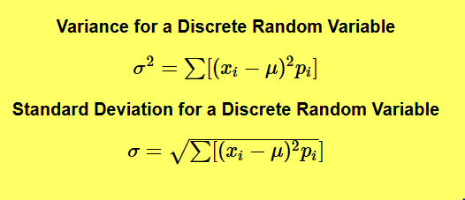
Standard Deviation
For instance, you may "expect" to win $20 when playing a particular game (which appears good!), but the spread for this might be from losing $20 to winning $60. Knowing such information can influence you decision on whether to play.

Slide 16
A class has 15 students whose ages are 14, 17, 15, 14, 21, 17, 19, 20, 16, 18, 20, 17, 16, 19 and 20 years. One student is selected in such a manner that each has the same chance of being chosen and the age X of the selected student is recorded. What is the probability distribution of the random variable X?
Find mean, variance and standard deviation of X.

Slide 17
probability you get 2 right when you guess as 3 True-False questions
True
TTT
TTF
TFT
TFF
FTT
FTF
FFT
FFF
0.5
True
0.5
False
0.5
True
0.5
=3/8
True
0.5
False
0.5
False
0.5
True
True
0.5
0.5
False
0.5
0.5
False
False
0.5
True
0.5
False
0.5

Slide 18
probability you get 20 right when you guess as 30 True-False questions

Slide 19
Binomial Random Variable
A specific type of discrete random variable that counts how often a particular event occurs in a fixed number of trials
Examples
Number of correct guesses at 30 true-false questions when you randomly guess all answers.
Number of winning lottery tickets when you buy 10 tickets of the same kind
Number of left-handers in a randomly selected sample of 100 unrelated people
Number of tails when flipping a coin 10 times

Slide 20
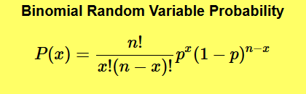
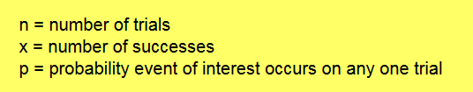
probability you get 20 right when you guess as 30 True-False questions

Slide 21
#exactly 4 correct answers by random attempts
dbinom(4, size=30, prob=0.5)
#having four or less correct answers by random attempts
pbinom(4, size=30, prob=0.5)

Slide 22
Cross-fertilizing a red and a white flower produces red flowers 25% of the time. Now we cross-fertilize five pairs of red and white flowers and produce five offspring.
Find the probability that there will be no red flowered plants in the five offspring.
P(X=0)
dbinom(0, size=5, prob=0.25)
probability that there would be one or fewer red flowered plants?
P(X<=1)
dbinom(0, size=5, prob=0.25) +dbinom(1, size=5, prob=0.25)
pbinom(1, size=5, prob=0.25)

Slide 23
For a variable to be a binomial random variable, ALL of the following conditions must be met:
There are a fixed number of trials (a fixed sample size)
On each trial, the event of interest either occurs or does not
The probability of occurrence (or not) is the same on each trial
Trials are independent of one another

Slide 24
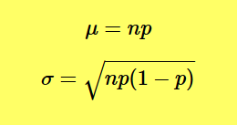
Expected Value and Standard Deviation
For instance, the “expected” number of correct (random) guesses at 30 True-False questions is np = (30)(.5) = 15 (half of the questions).

Slide 25
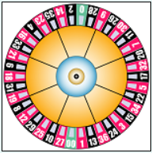
A roulette wheel has 38 slots, 18 are red, 18 are black, and 2 are green. You play five games and always bet on red.
What is the probability that you will win all five games?
P(X=5)= dbinom(5,size=5, prob=18/38)

Slide 26
A roulette wheel has 38 slots, 18 are red, 18 are black, and 2 are green. You play five games and always bet on red.
What is the probability that you will win no more than two games?
P(X<=2)= pbinom(2,size=5, prob=18/38)

Slide 27
A roulette wheel has 38 slots, 18 are red, 18 are black, and 2 are green. You play five games and always bet on red.
How many games can you expect to win?

Slide 28
You sell sandwiches. 70% of people choose veg, the rest choose non-veg.
What is the probability of selling 2 veg sandwiches to the next 3 customers?

Slide 29
Your company makes sports bikes. 90% pass final inspection (and 10% fail and need to be fixed).
What is the expected mean and variance of the 4 next inspections?

Slide 30
There are twelve multiple choice questions in an English class quiz. Each question has five possible answers, and only one of them is correct.
Find the probability of having four or less correct answers if a student attempts to answer every question at random.

Slide 31
Ten eggs are drawn successively with replacement from a lot containing 10% defective eggs. Find the probability that there is at least one defective egg.

Slide 32
It is known that 10% of certain articles manufactured are defective. What is the probability that in a random sample of 12 such articles, 9 are defective?

